Slide 1
Emotions experienced while performing robotic activities
Gülay YAVUZ

Slide 2
204 students participated in the research. 10 students were not included in the study because there were deficiencies in their form. The data of 194 students were analyzed.
Gender
Female | 89
Male | 104
Empty | 1
Class
Middle School (5-6-7-8) | 170
High School (9-10-11-12) | 16
SEL POINTS
SEL 30< <70 | 44
SEL >70 | 150
The average age : 13,4

Slide 3
Percentage of the emotions experienced by 186 students who took the robotics course during their robotic activities

Slide 6
Robotic activities
Tasks and emotions
Notes:
Before the assignments were given, sustainable development goals were discussed, the website was examined and what kind of projects could be done was discussed.

Slide 7
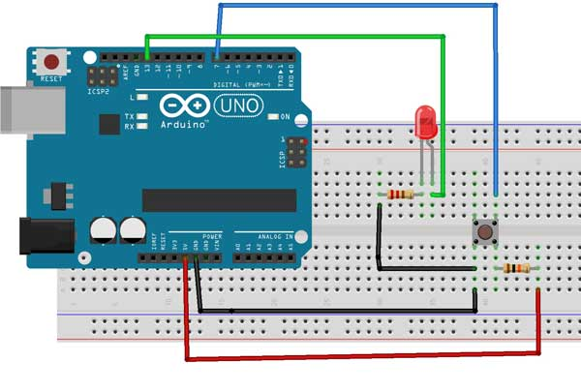
Robotic activities
Tasks
Task 1: Collaborative, Difficulty Level: Hard
Turn on the leds with the button
Using a button, creating a circuit that makes an LED turn on when the button is pressed once and then turns off when the button is pressed a second time.
Materials : button, resistor, breadboard, arduino,jumper cables, usb cable,

Slide 9
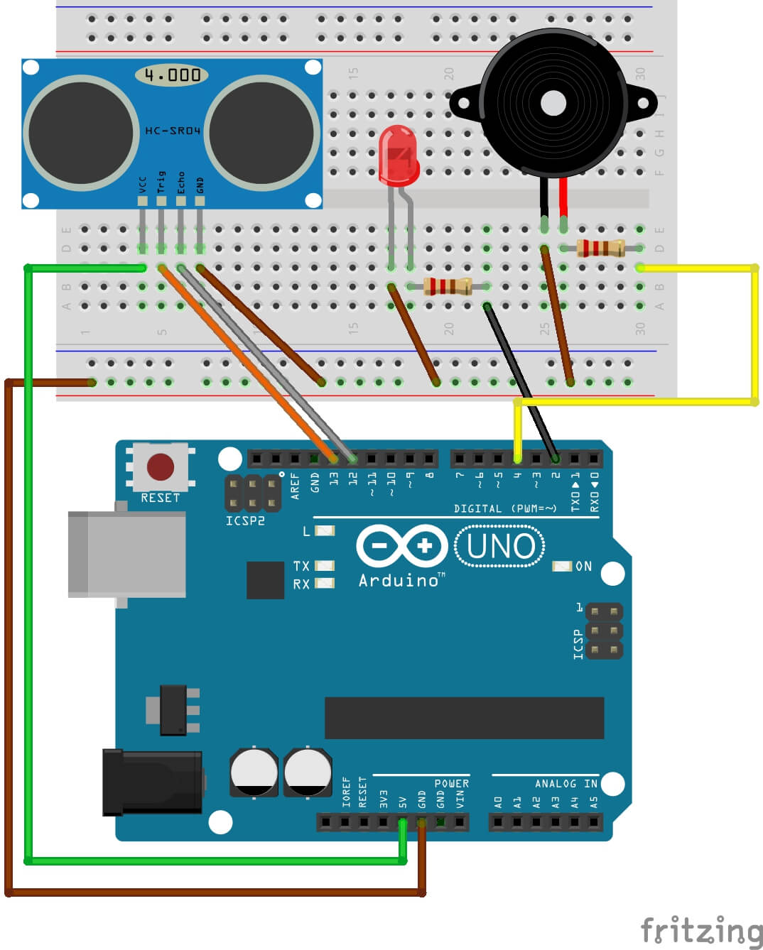
Robotic activities
Tasks
Task 2: Individual , Somewhat hard
Parking system
When an object approaching more than 25 cm to the student distance sensor is detected, it creates a warning circuit by making a sound.

Slide 11
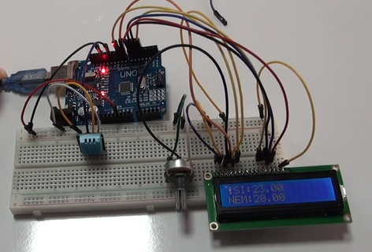
Robotic activities
Tasks
Task 3: Individual , hard
Smart Agriculture Project
SDG (sustainable development goals) :
12. RESPONSIBLE CONSUMPTION & PRODUCTION

Slide 13
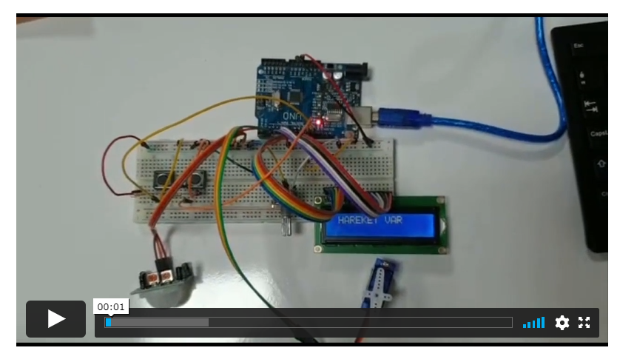
Robotic activities Tasks
Task 4: Collaborative, Somewhat hard
Project Name: Security system
Materials: LCD screen, Motion sensor (PIR), buttons, servo motor, potentiometer, resistor, breadbord, arduino, jumper cables, usb cable,
They made their projects by watching videos on moodle.
http://bote1.hacettepe.edu.tr/moodle/mod/page/view.php?id=11588

Slide 15
When take the task

Slide 16
When take the task

Slide 17
When take the task

Slide 18
When take the task

Slide 19
While working on the task

Slide 20
While working on the task

Slide 21
While working on the task

Slide 22
While working on the task

Slide 23
When complete the task

Slide 24
When complete the task

Slide 25
When complete the task

Slide 26
When complete the task

Slide 27
Conclusion
It was observed that more students experienced anxiety in hard tasks than intermediate level. (Both collaborative and individual)
It was observed that they experienced more anxiety when working collaboratively than when working individually.
Notes:
Görev zorluğuna göre baktığımızda;
zor görevlerde orta seviyedekilere göre daha fazla öğrencinin kaygı yaşadıkları görülmüştür. (Hem İşbirlikli be bireysel çalışırken)
İşbirlikli çalışırken bireysel çalışmaya göre daha fazla kaygı yaşadıkları görülmüştür.

Slide 28
Conclusion
It has been observed that the students intensely experience positive emotions such as happiness, excitement, interest and curiosity, as well as negative emotions such as anxiety when they take the task. It is seen that there are no students who express negative emotions too much.
It has been observed that while working on the task, anxiety decreases along with positive emotions. Students stated that they experienced confusion in this process.
It has been observed that this stage is the process in which the greatest variety of emotions is experienced.
It was observed that the feeling of happiness reached the highest level when they completed the task, and at the same time, the feeling of pride and relaxation was expressed intensely by the students.
Notes:
Öğrencilerin görevi aldıklarında mutluluk, heyecan, ilgi merak gibi olumlu duyguların yanısıra kaygı gibi olumsuz sayılabilecek duyguyu da yoğun olarak yaşadıkları görülmüştür. Olumsuz duyguları çok fazla ifade eden öğrenci olmadığı görülmektedir.
Görev üzerinde çalışırken olumlu duygularla birlikte kaygının da azaldığı görülmüştür. Öğrenciler bu süreçte kafa karışıklığı yaşadıklarını ifade etmişlerdir.
En fazla duygu çeşitliliği yaşanan sürecin bu aşama olduğu görülmüştür.
Görevi tamamladıklarında mutluluk duygusunun en yüksek seviyeye ulşatığı aynı zamanda gurur rahatlamanın da öğrenciler tarafından yoğun olarak ifade edildiği görülmüştür.

Slide 29
Thank you!

