Slide 1
EMOTIONS AND ROBOTICS
A Study Across Different Cultures, Educational Systems and Populations
EXAMINATION OF EMOTIONS
EXPERIENCED BY GIFTED STUDENTS IN ROBOTICS COURSES
THROUGH DIGITAL STORYTELLING WORKSHOP
Hatice ÇIRALI SARICA
haticecirali@hacettepe.edu.tr h.cirali@gmail.com
Department of Computer Education and Instructional Technology, Faculty of Education, Hacettepe University, TURKEY

Slide 4
EMOTIONS AND ROBOTICS
A Study Across Different Cultures, Educational Systems and Populations
Digital Storytelling
Introduction
Purposes
"The emotions brought by the stories come directly from people’s hearts" (Qiongli, 2009).
Methodology
Findings

Slide 5
EMOTIONS AND ROBOTICS
A Study Across Different Cultures, Educational Systems and Populations
This study aims to reveal the emotions experienced by gifted students during the robotics learning process through digital storytelling workshop.
Research question:
What are the emotions experienced by gifted students during the robotics learning process? Why?
Introduction
Purposes
Methodology
Bulgular
Findings

Slide 6
EMOTIONS AND ROBOTICS
A Study Across Different Cultures, Educational Systems and Populations
Method
Case study
Introduction
Researchers’ Role
Facilitators
Purposes
Participants
12 secondary school students (7 boys and 5 girls), studying at the ARKAS Science and Art Center in İzmir, TURKEY.
Methodolgy
ODSTW Process
Bulgular
The DSTW process was carried out in one half day and one full day.
Findings
Data Collection Tools
Audio recordings of all conversations of participants during the DSTW process
Digital stories
Data Analysis
Content Analysis using Maxqda 2018 program

Slide 7
EMOTIONS AND ROBOTICS
A Study Across Different Cultures, Educational Systems and Populations
Digital Storytelling Workshop Process
(adopted from Şimşek [18])
Introduction
Story circle
Writing the story
Voice recording
Preparing
visuals
Video editing / Creating digital story
In-group screening
Purposes
Methodolgy
Bulgular
Findings

Slide 8
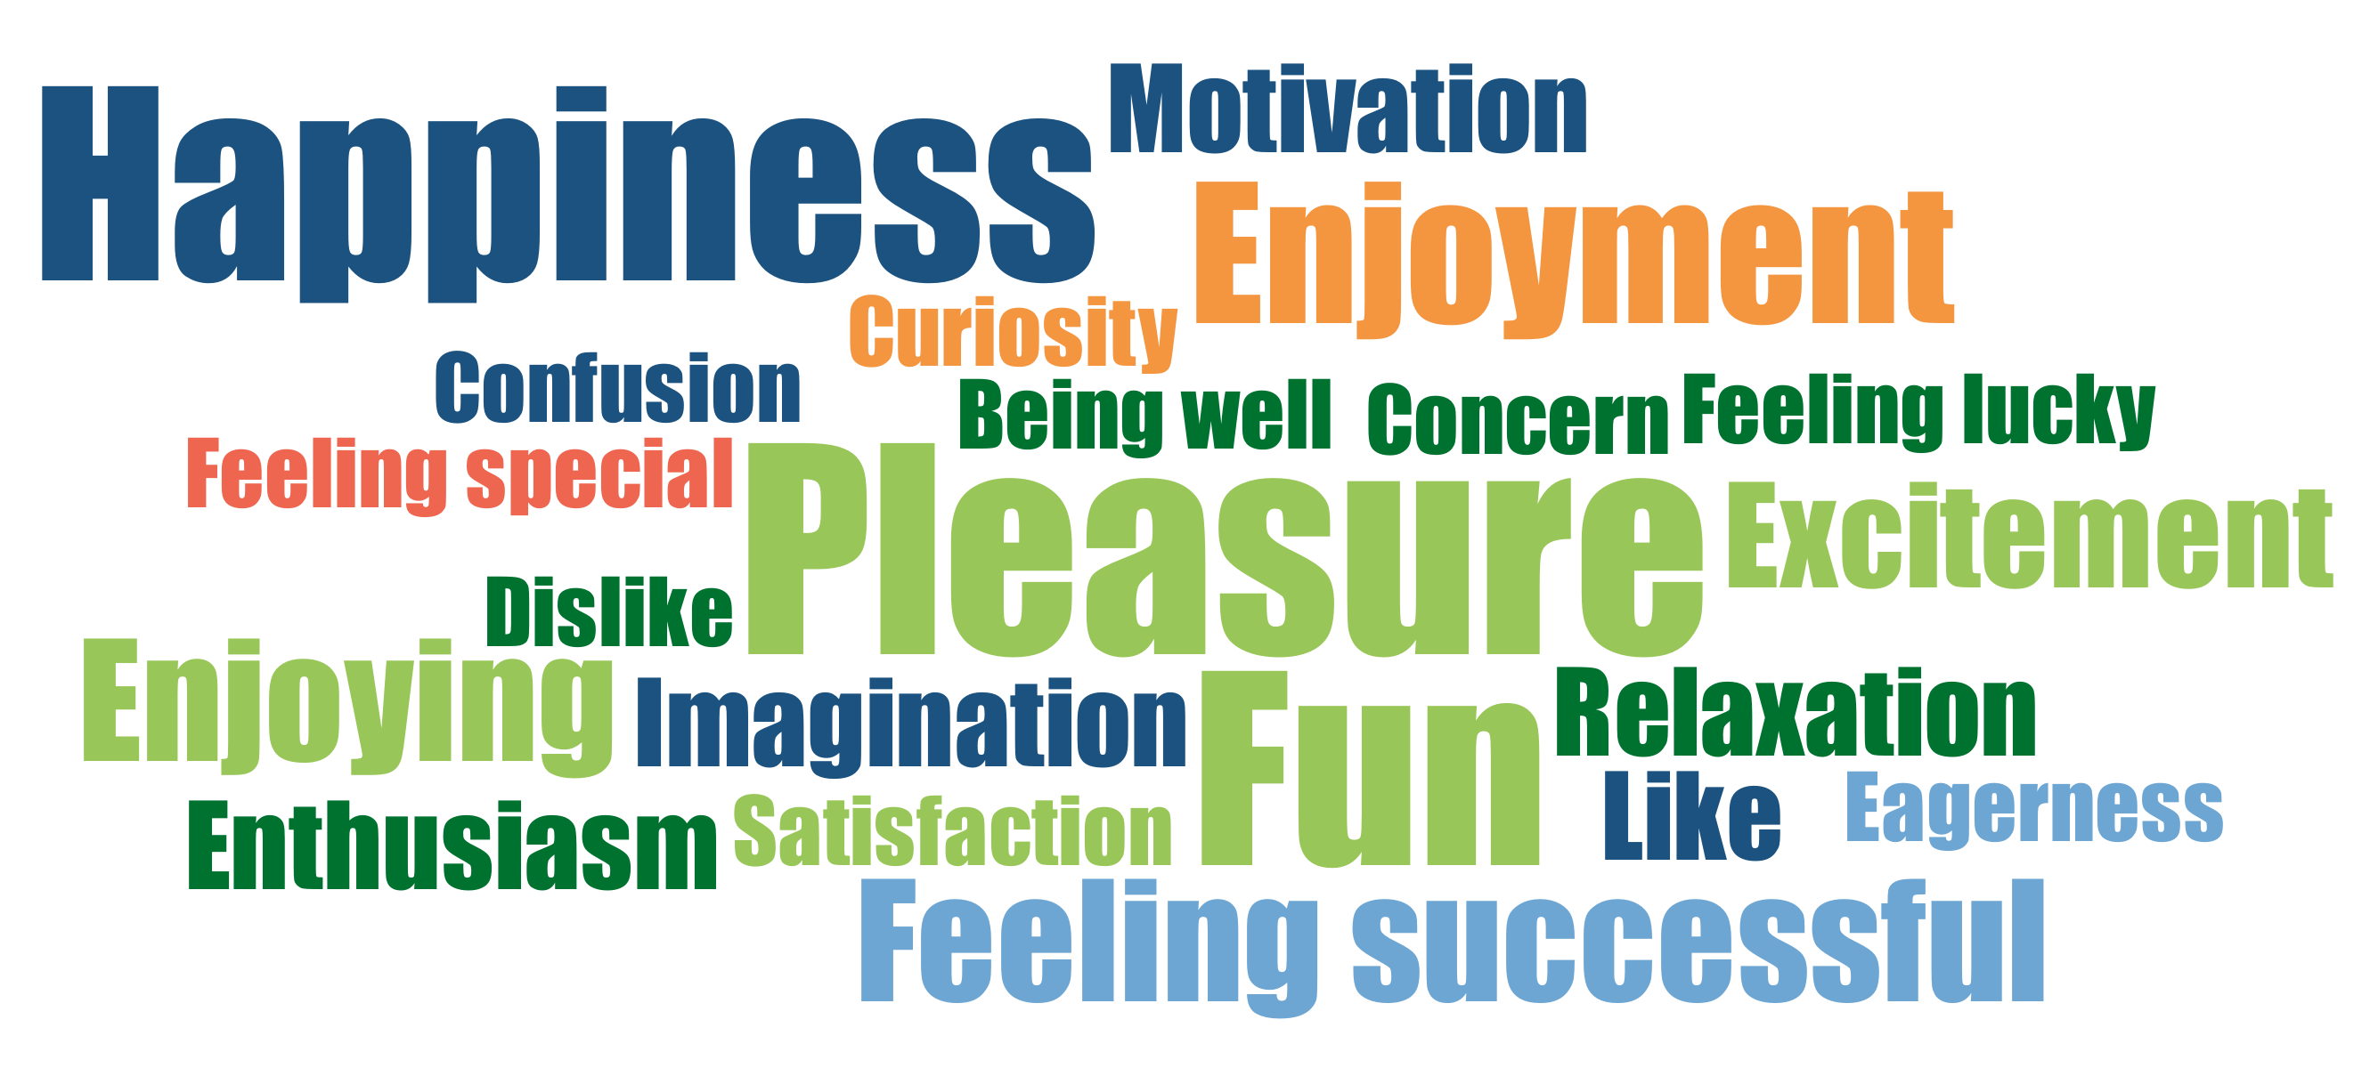
EMOTIONS AND ROBOTICS
A Study Across Different Cultures, Educational Systems and Populations
Emotions of Students in Robotics Lessons
Introduction
Purposes
Methodology
Bulgular
Findings

Slide 9
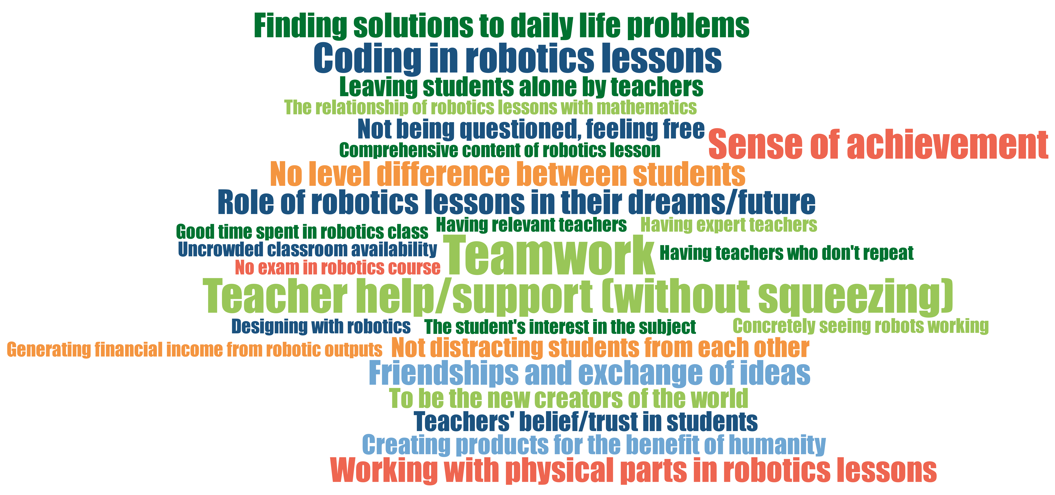
EMOTIONS AND ROBOTICS
A Study Across Different Cultures, Educational Systems and Populations
Incidents that play a role in students' emotions
Introduction
Purposes
Methodology
Bulgular
Findings

Slide 10
EMOTIONS AND ROBOTICS
A Study Across Different Cultures, Educational Systems and Populations
Incidents that play a role in students' emotions
Introduction
“I enjoy using the topics that we learned and improved ourselves in robotics lessons to solve problems in daily life”
Purposes
Methodology
Bulgular
Findings

Slide 11
EMOTIONS AND ROBOTICS
A Study Across Different Cultures, Educational Systems and Populations
Incidents that play a role in students' emotions
Introduction
“It's really nice and crazy to be the new creators of this virtualized and robotized new world. It becomes more enjoyable with coding from applications like Python or MBlock and tools like Arduino UNO. Honestly, I love the coding part of robotics.”
Purposes
“It's really nice and crazy to be the new creators of this virtualized and robotized new world. It becomes more enjoyable with coding from applications like Python or MBlock and tools like Arduino UNO. Honestly, I love the coding part of robotics.”
Methodology
Bulgular
Findings

Slide 12
EMOTIONS AND ROBOTICS
A Study Across Different Cultures, Educational Systems and Populations
“In the robotics lesson, teachers understand us and do not make repetitions unless absolutely necessary. They support without squeezing. It makes me feel happy and excited.”
Incidents that play a role in students' emotions
Introduction
Purposes
Methodology
Bulgular
Findings

Slide 13
EMOTIONS AND ROBOTICS
A Study Across Different Cultures, Educational Systems and Populations
“In the robotics lesson, teachers understand us and do not make repetitions unless absolutely necessary. They support without squeezing. It makes me feel happy and excited.”
Incidents that play a role in students' emotions
“If my mood is low, I become even more pessimistic, so I think these robotics teachers support me with little tips, even if I know it
Introduction
Purposes
Methodology
Bulgular
Findings

Slide 14
EMOTIONS AND ROBOTICS
A Study Across Different Cultures, Educational Systems and Populations
Incidents that play a role in students' emotions
Introduction
“I love my friends who give me ideas and support more, and I enjoy working with them more.
Purposes
Methodology
Bulgular
Findings

Slide 15
EMOTIONS AND ROBOTICS
A Study Across Different Cultures, Educational Systems and Populations
Introduction
In conclusion
DST was a reflective tool for students.
DST facilitated emotional sharing.
Purposes
Methodology
Bulgular
Findings

Slide 16
TEŞEKKÜR EDERiM
19/20

