Slide 1
Emotions and Robotics with Video Analytics
Gökhan Akçapınar, PhD.

Slide 2
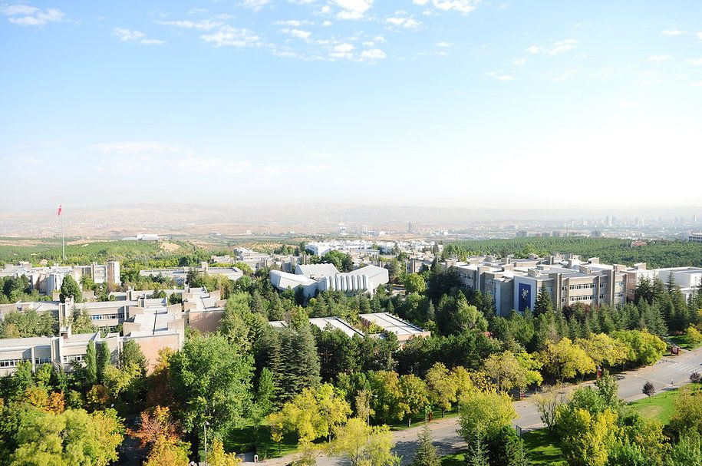
Self introduction
2020: Associate Professor: Computer Education and Instructional Technology Department, Hacettepe University, Turkey
2018: PostDoc: Learning and Educational Research Unit, Kyoto University, Japan
2014: PhD in Educational Technology (Developing early warning system for At-Risk students)
2010: Visiting Researcher: University of Groningen, Netherlands
2007: Master: Computer Education and Instructional Technology Department, Hacettepe University, Turkey

Slide 3
Agenda
Affect (emotions) detection
Video analytics
Video log analysis
Computer vision based analysis
Turkey case study: engagement detection (initial results)
Future studies

Slide 4
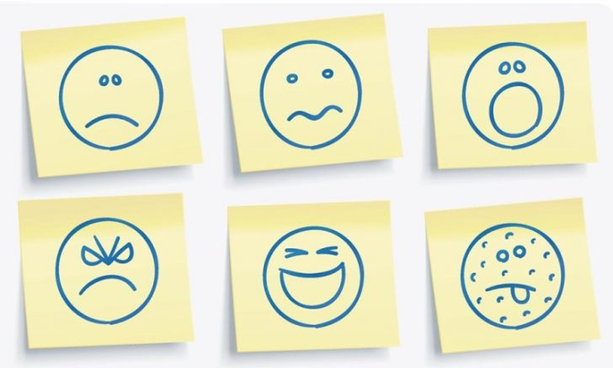
Objective
Trying to understand students’ affective states/emotions while they are engaging robotic activities through multi modal video analytics.

Slide 5
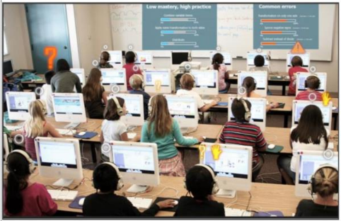
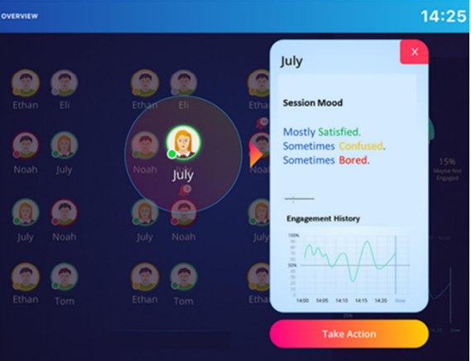
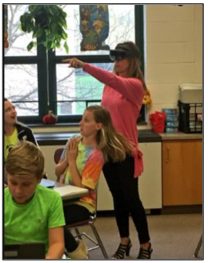
Affect detection
Holstein et al., 2018
Aslan et al., 2019

Slide 6
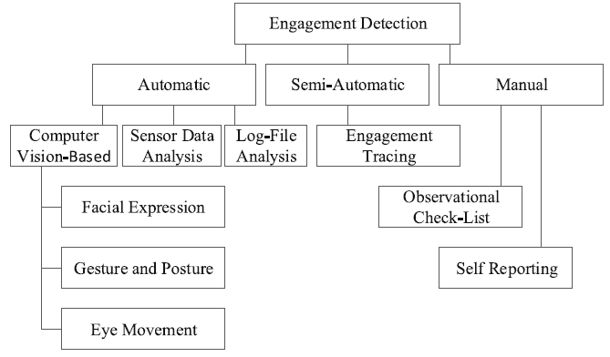
Affect detection methods (my interest)
Affect Detection
Dewan, M.A.A., Murshed, M. & Lin, F. Engagement detection in online learning: a review. Smart Learn. Environ. 6, 1 (2019). https://doi.org/10.1186/s40561-018-0080-z

Slide 7
Case study
Moodle
5 short videos
45 students
~20,000 rows of logs

Slide 8
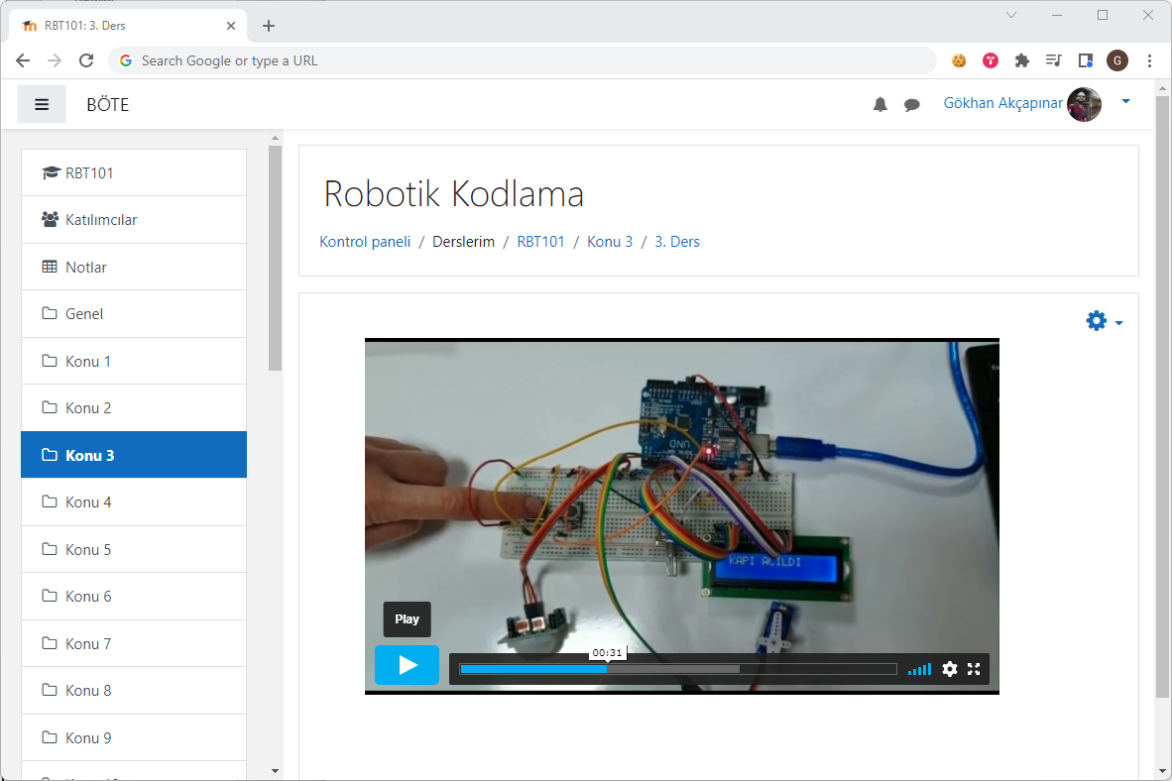
Data collection tool

Slide 9
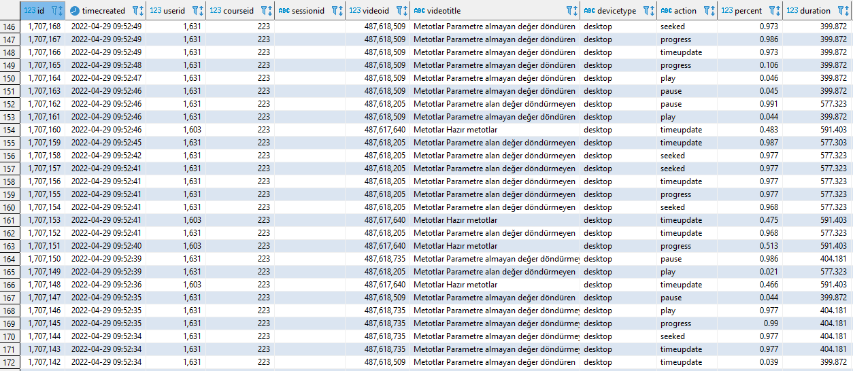
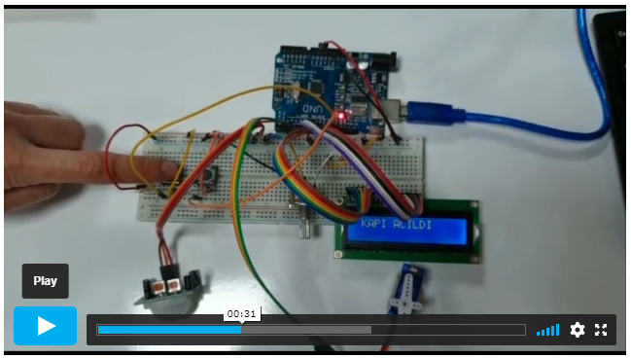
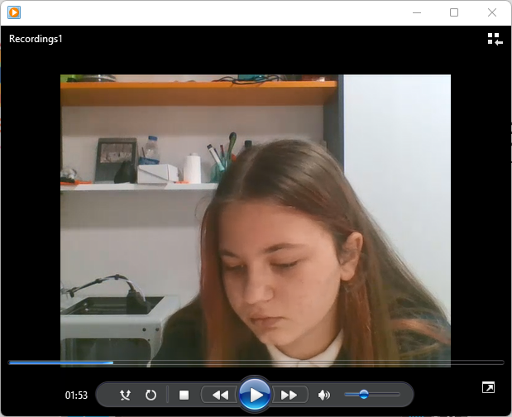
Multimodal data collection
Video logs
Screen recording
Students’ face and posture

Slide 10
Video logs

Slide 11
Log file analysis
Metric | Description
sessionduration | Duration of a session in terms of minutes
totalaction | Total number of actions in a session
play | Number of times play button was pressed in a session
pause | Number of times paused button was pressed in a session
backward | Number of times a video was backwarded in a session
forward | Number of times a video was forwarded in a session
maxpercent | Maximum point reached in the timeline of the video in terms of percentage (for example, after loading the video, skipping to 90% in the timeline and watching 5% more would result in 95%).
totalpercent | Total percentage of video portion watched.
timeupdate | Number of auto-recorded events every 5 sec while students watching the video

Slide 12
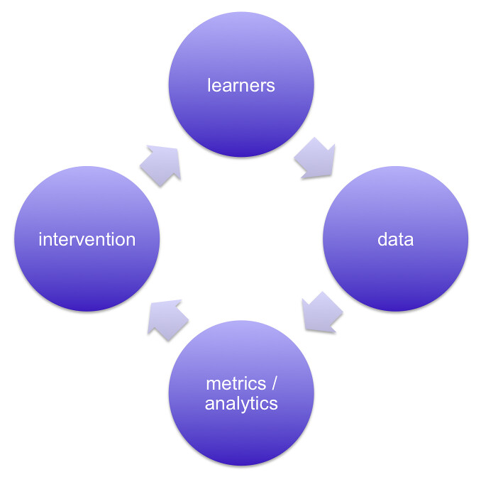
Learning Analytics
Learning analytics is the measurement, collection, analysis and reporting of data about learners and their contexts, for purposes of understanding and optimising learning and the environments in which it occurs (SOLAR, 2012).
Learning Analytics Cycle (Clow, 2012)

Slide 13
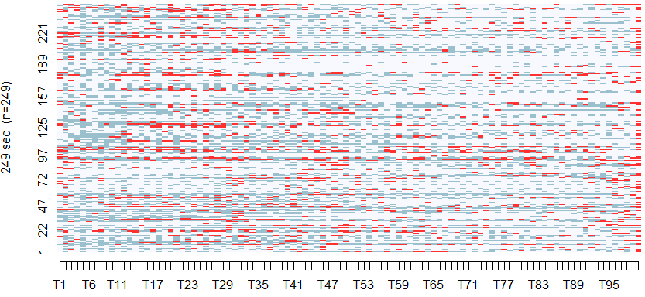
Data analysis

Slide 14
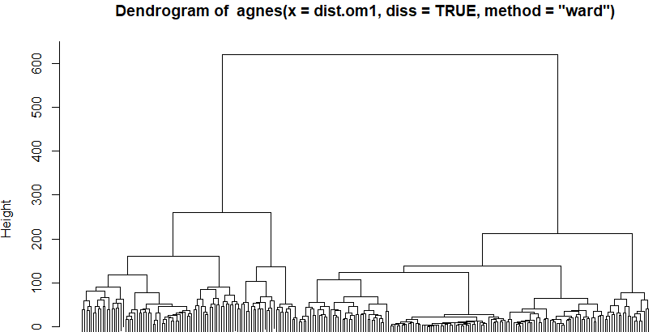
Clustering of video sessions
Cluster 1
Cluster 2

Slide 15
Clustering of video sessions

Slide 16
Results

Slide 17
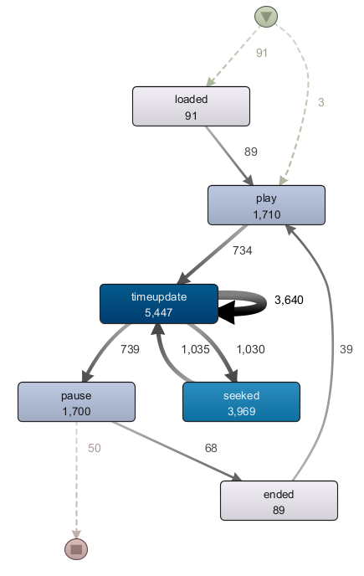
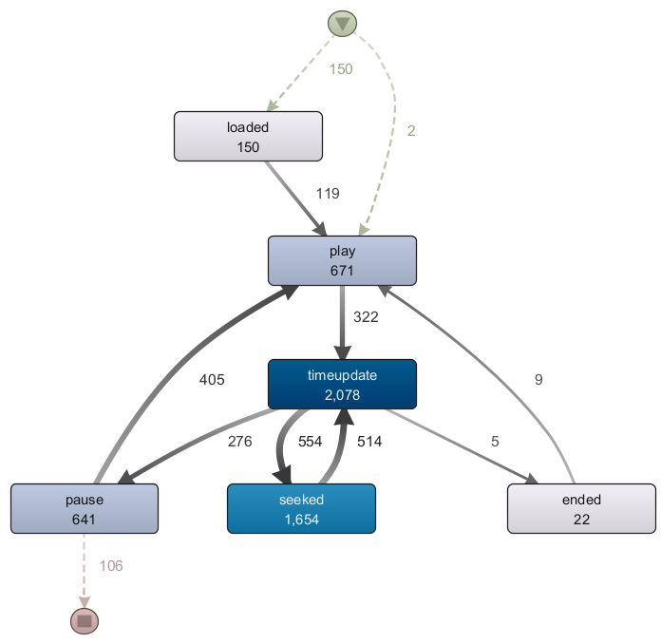
Process model of clusters
Cluster 1
Cluster 2

Slide 18
Conclusions
Helping students
Personalized learning
Helping teachers
Class orchestration
Developers, instructional designers
Developing better tools, better learning environments

Slide 19
Computer vision based approach

Slide 20
Thank You!

