Slide 1
Welcome & short introduction
Ingrid van de Groep & Wouter van der Laan

Slide 2
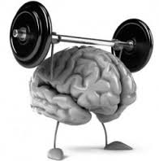
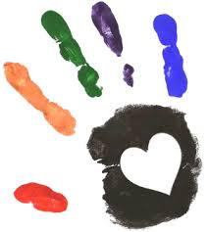
want to feel (conscious) mental focus thinking & doing
Connection and ratio

Slide 3
What do you need for this?
‘Relationship-autonomy-competence’
Relationship: 'I belong' Unconditional love; every day a new chance Adult Safety: Physical & Emotional Vitality (sleeping, eating, playing) Giving confidence as an adult

Slide 4
Ontspanning-inspanning-ontspanning-inspanning...
om werkhouding & focus tot ontwikkeling laten komen
Research has shown that there is a strong relationship between:
working memory and learning performance
Competency: "I can do it"
Three parts of working memory:
verbal working memory exercises
visual working memory exercises
instruction language exercises
Autonomy (ownership): 'I can and want to do it myself’
- Inner language to direct yourself

Slide 5
Now yourself ... get started

