Slide 1
ESPROMINHO EUROPEAN CLUB
Project Dissemination

Slide 2
WE- Welcome Emotions
2022

Slide 3
January 22
Project: We - Welcomemotions
8 a 15 January 2022
Izmir, Turquia

Slide 4
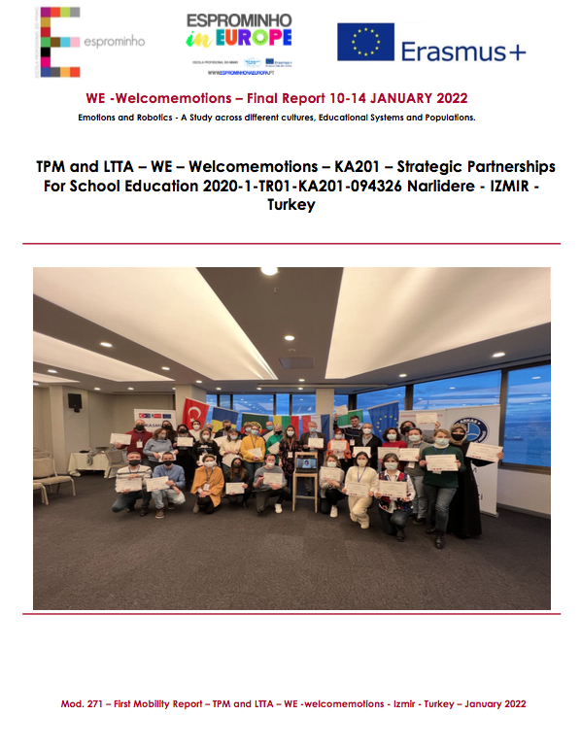
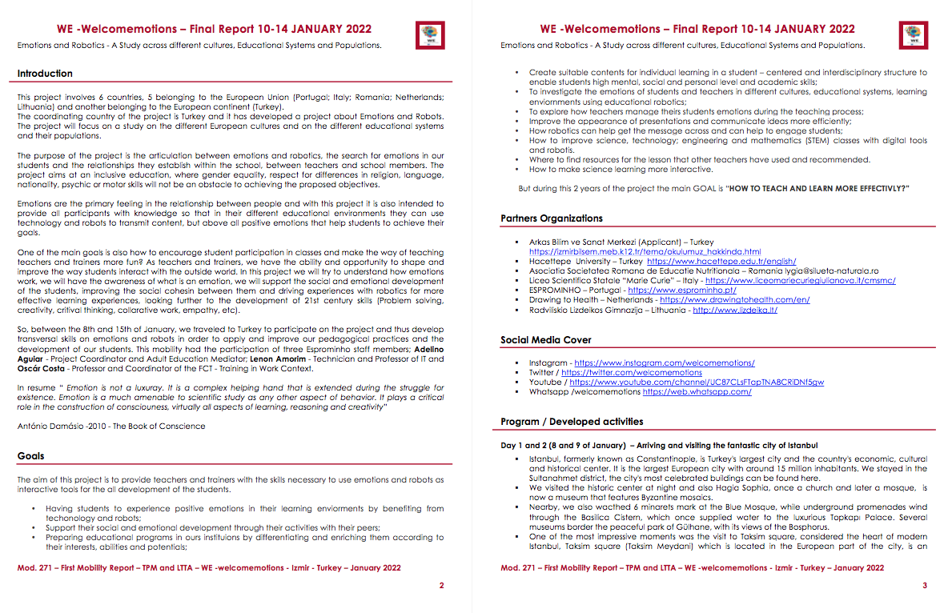
January 22
Project: We - Welcomemotions

Slide 5
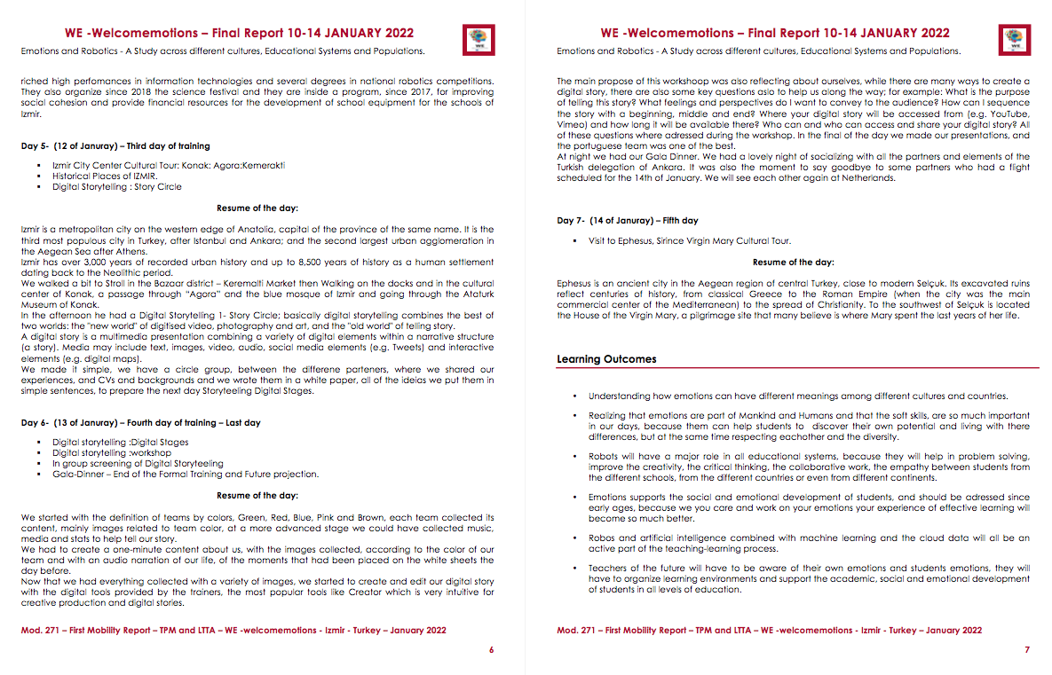
January 22
Project: We - Welcomemotions

Slide 6
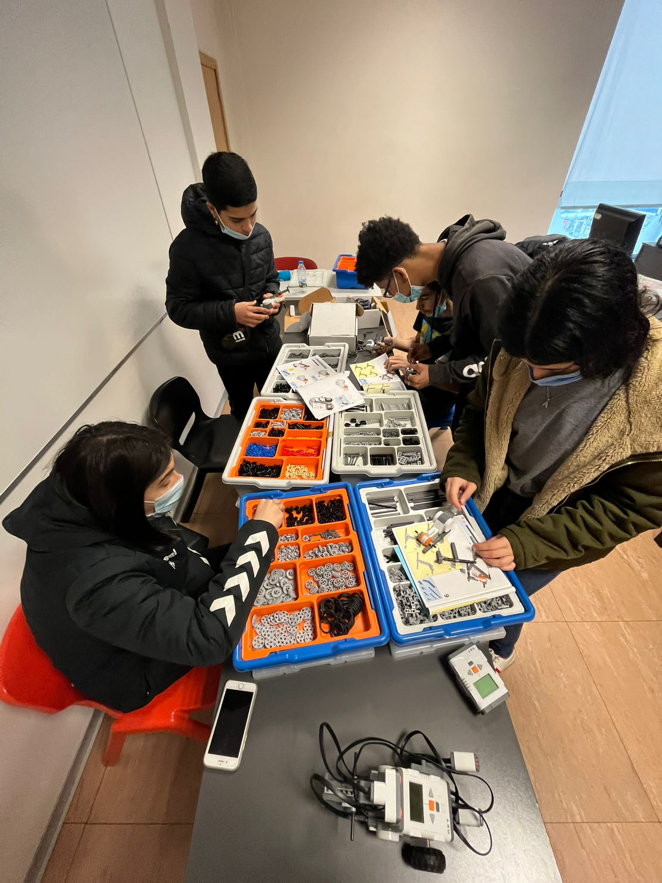
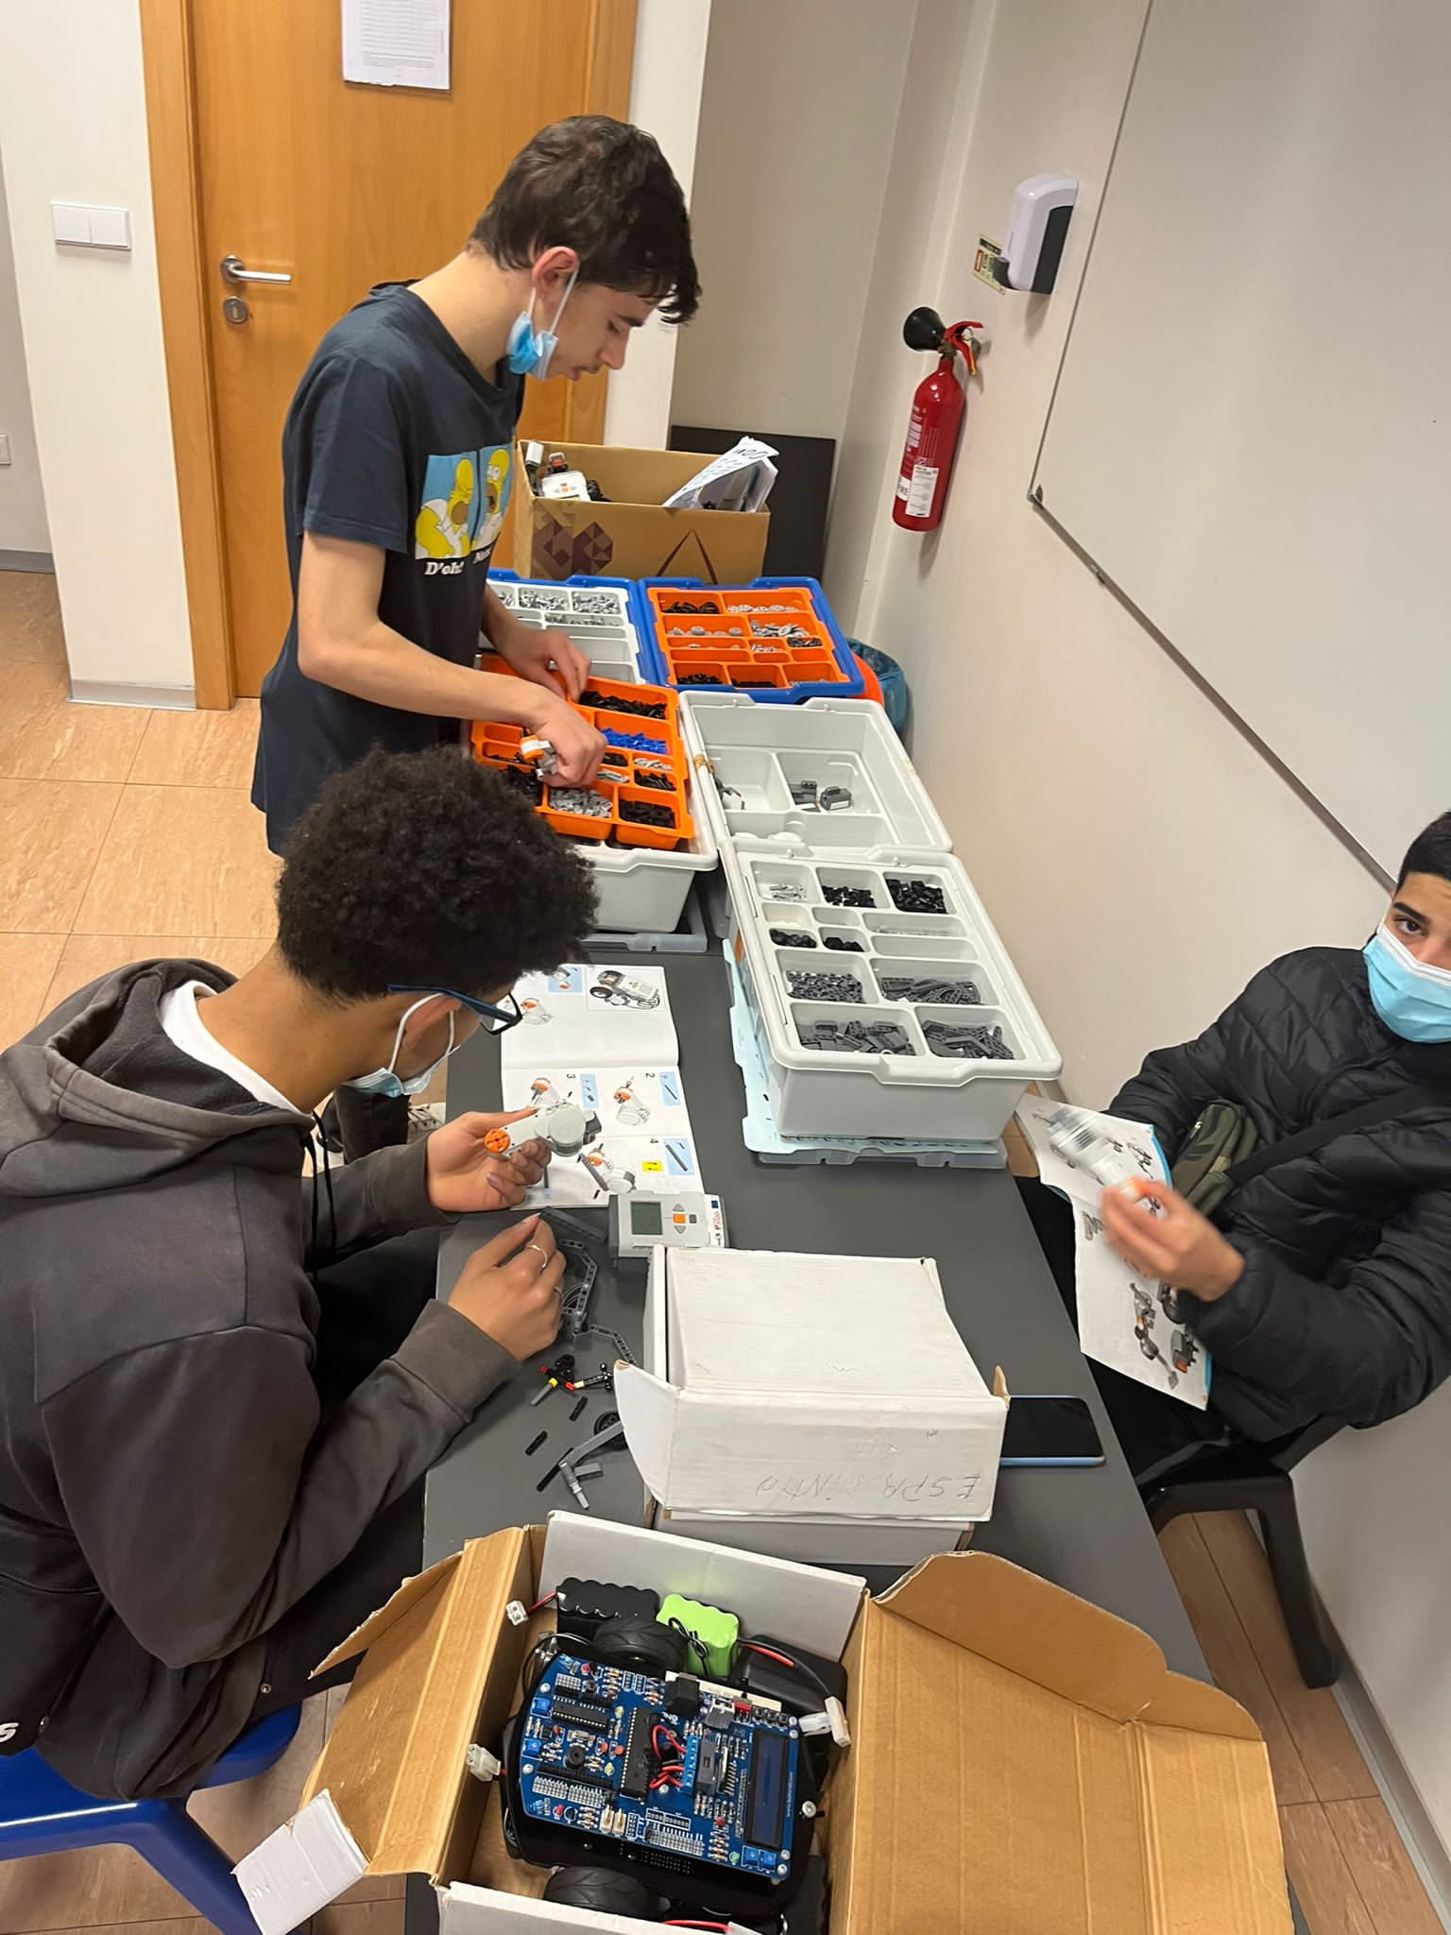
February/March 22
Project: We – Welcomemotions
We started to work on simple tasks, with the students and we select a few of them to represent the class.
We choose the students from different levels of education 8ªgrade and 10ªgrade.
Two teachers of IT are responsible for the Implementation of the work inside class.

Slide 7
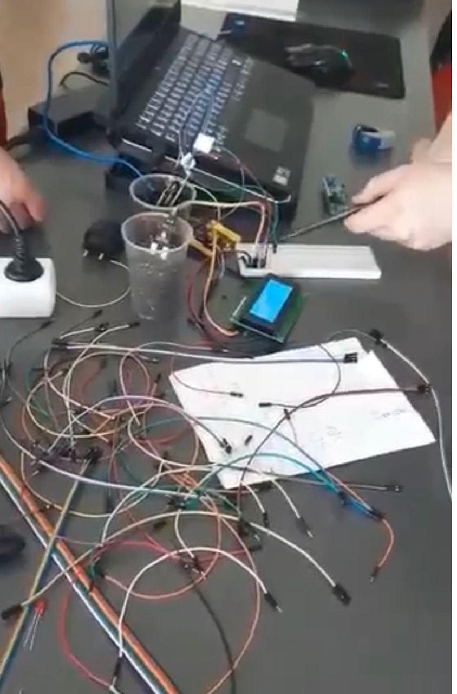
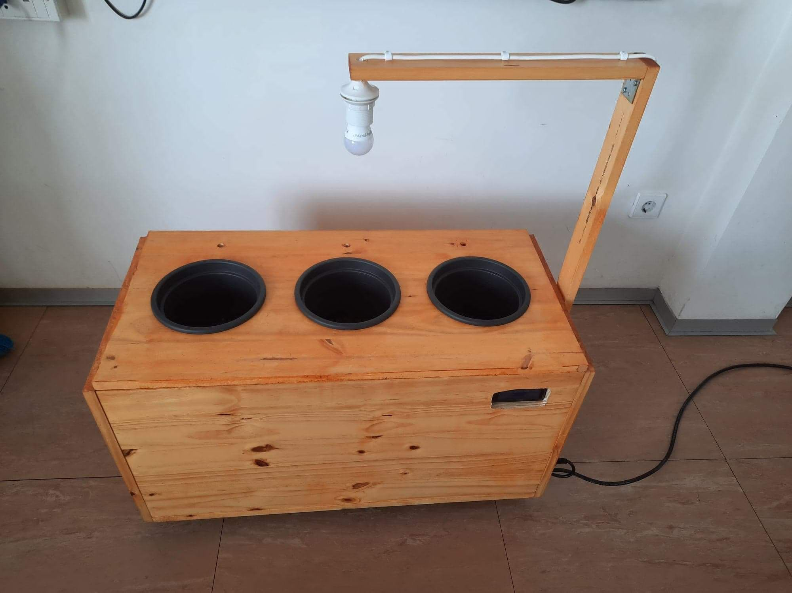
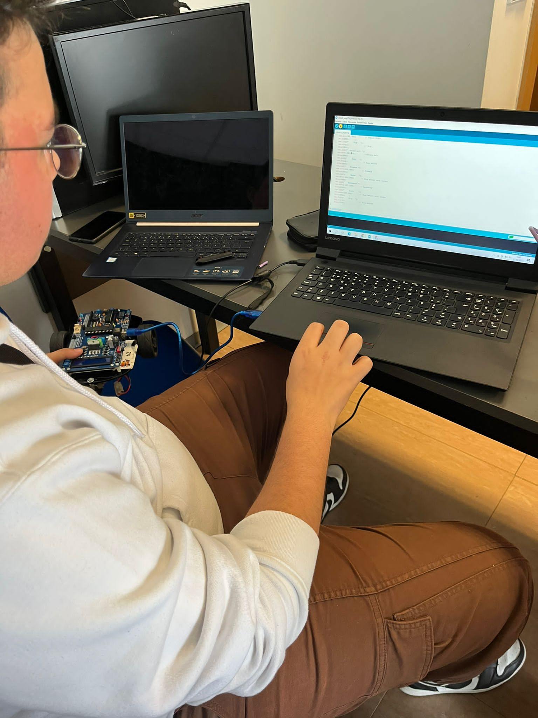
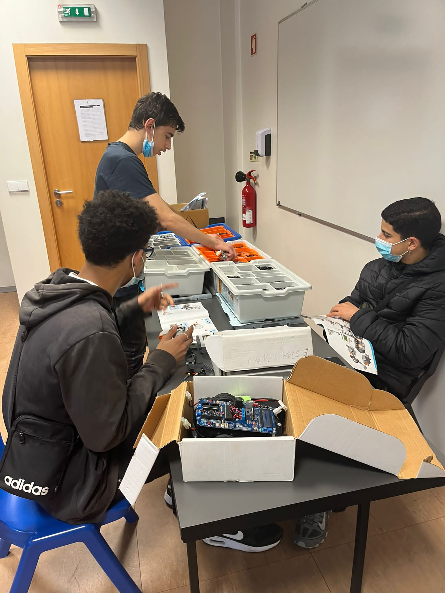
February/March 22
We also defined the Sustainable Development Goal – Climate Change And Smart Cities with revolution of IOT.
Temperature Humidity Sensor plus Sensor Light

Slide 8
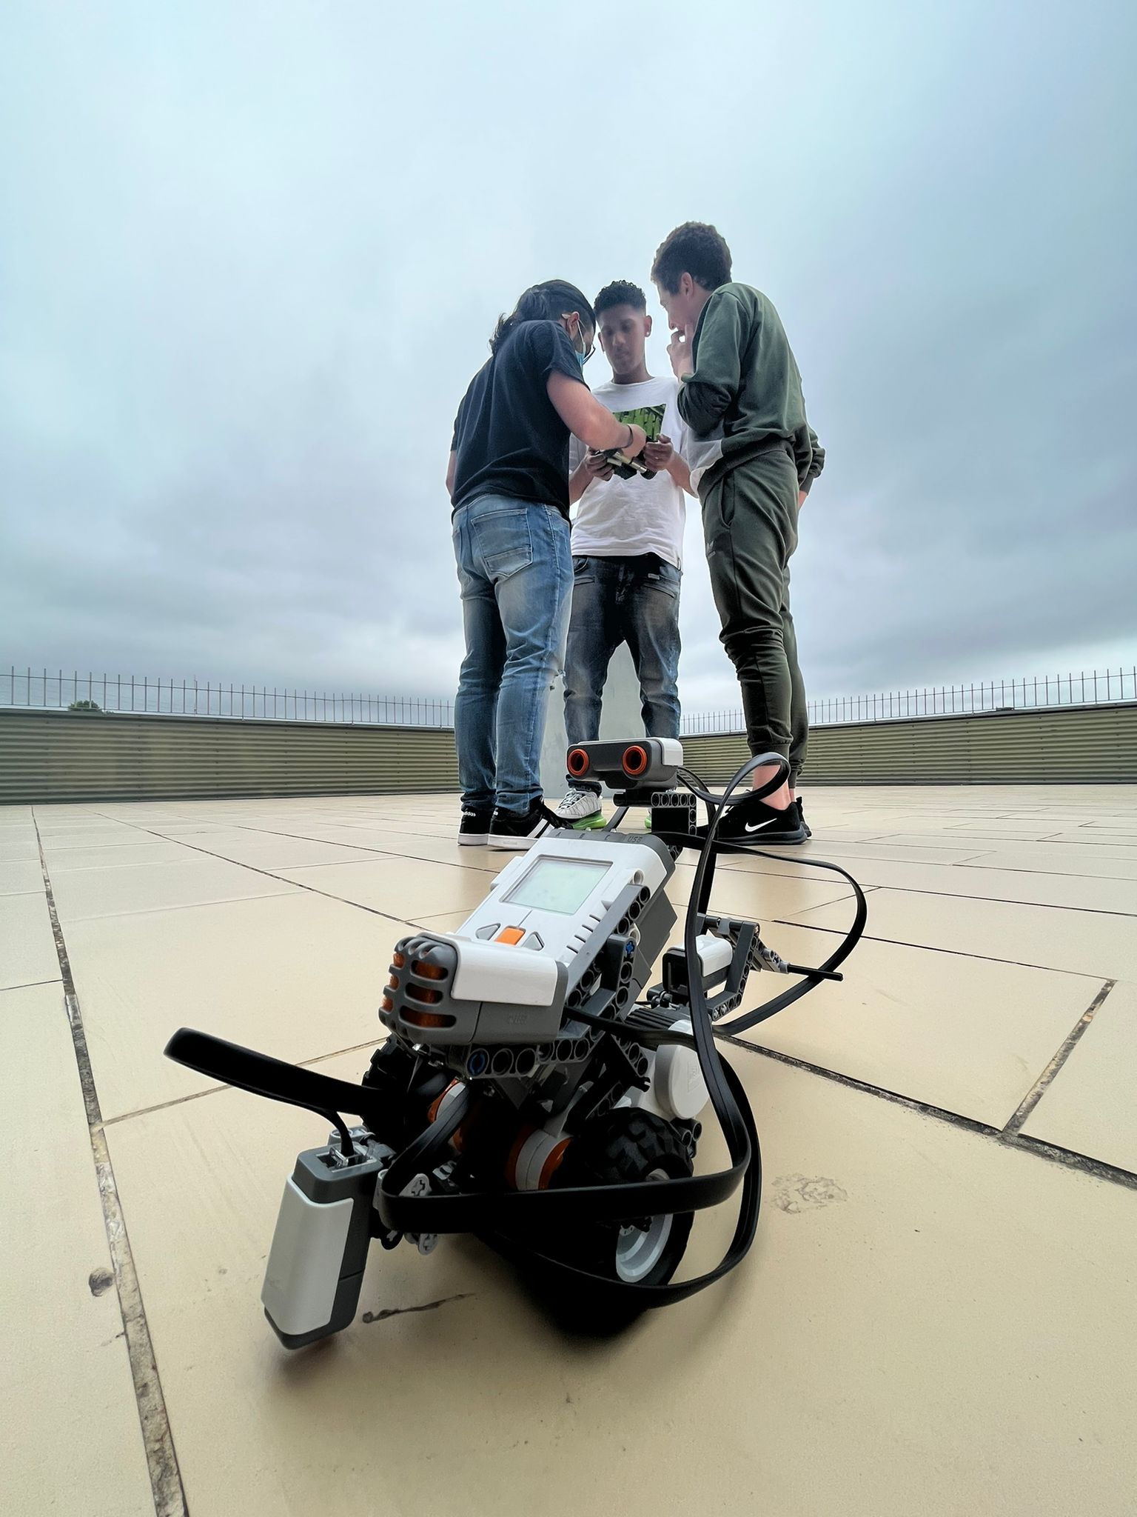
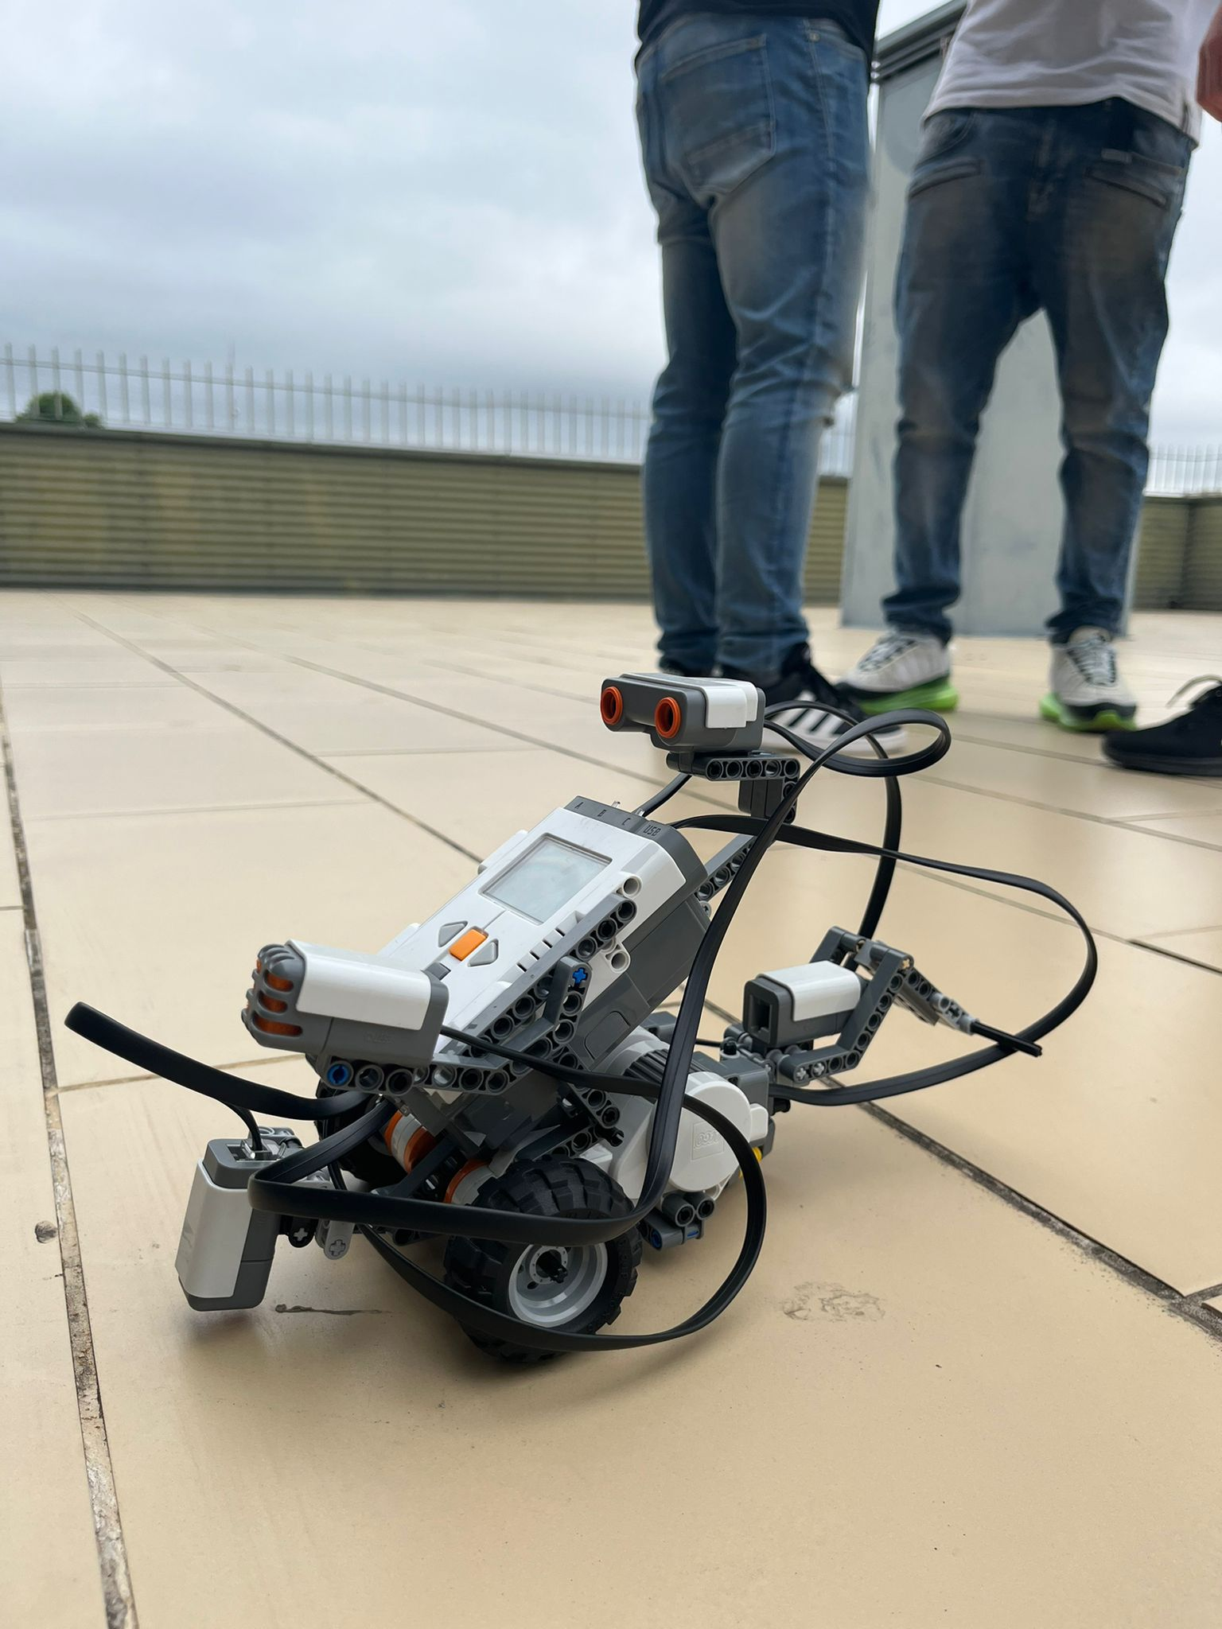
April/May 22
In, April, we only did the continuation of the work in small steps - because in Portugal we have the break of Easter Holidays.
In, May we start to develop the project to another level and using robots to rescue and automation.

Slide 9
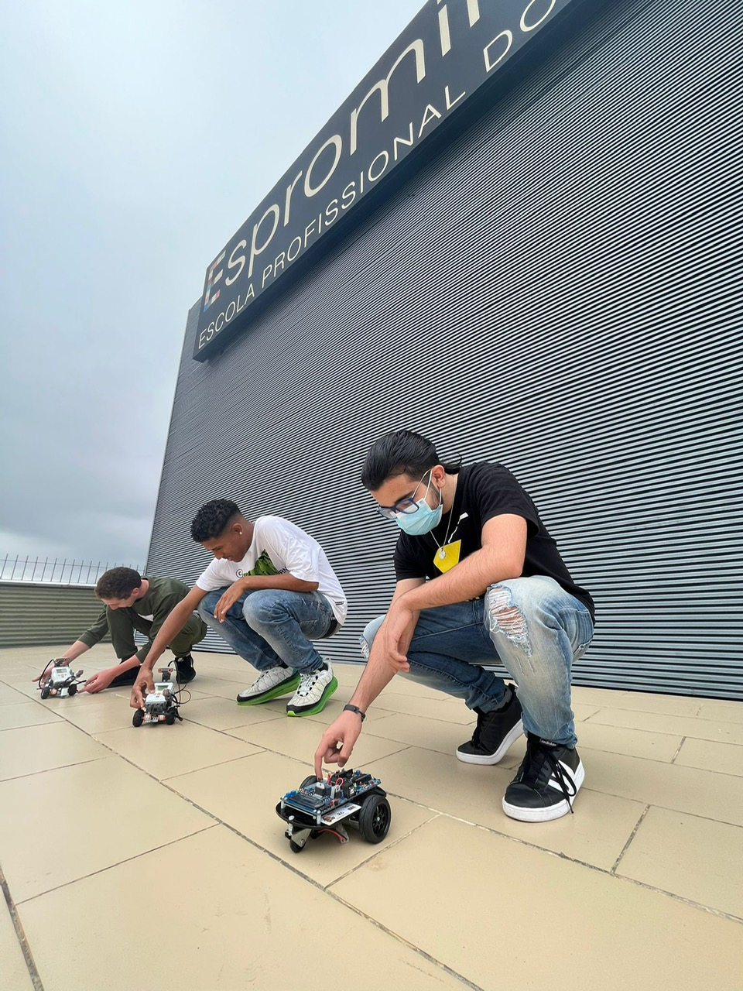
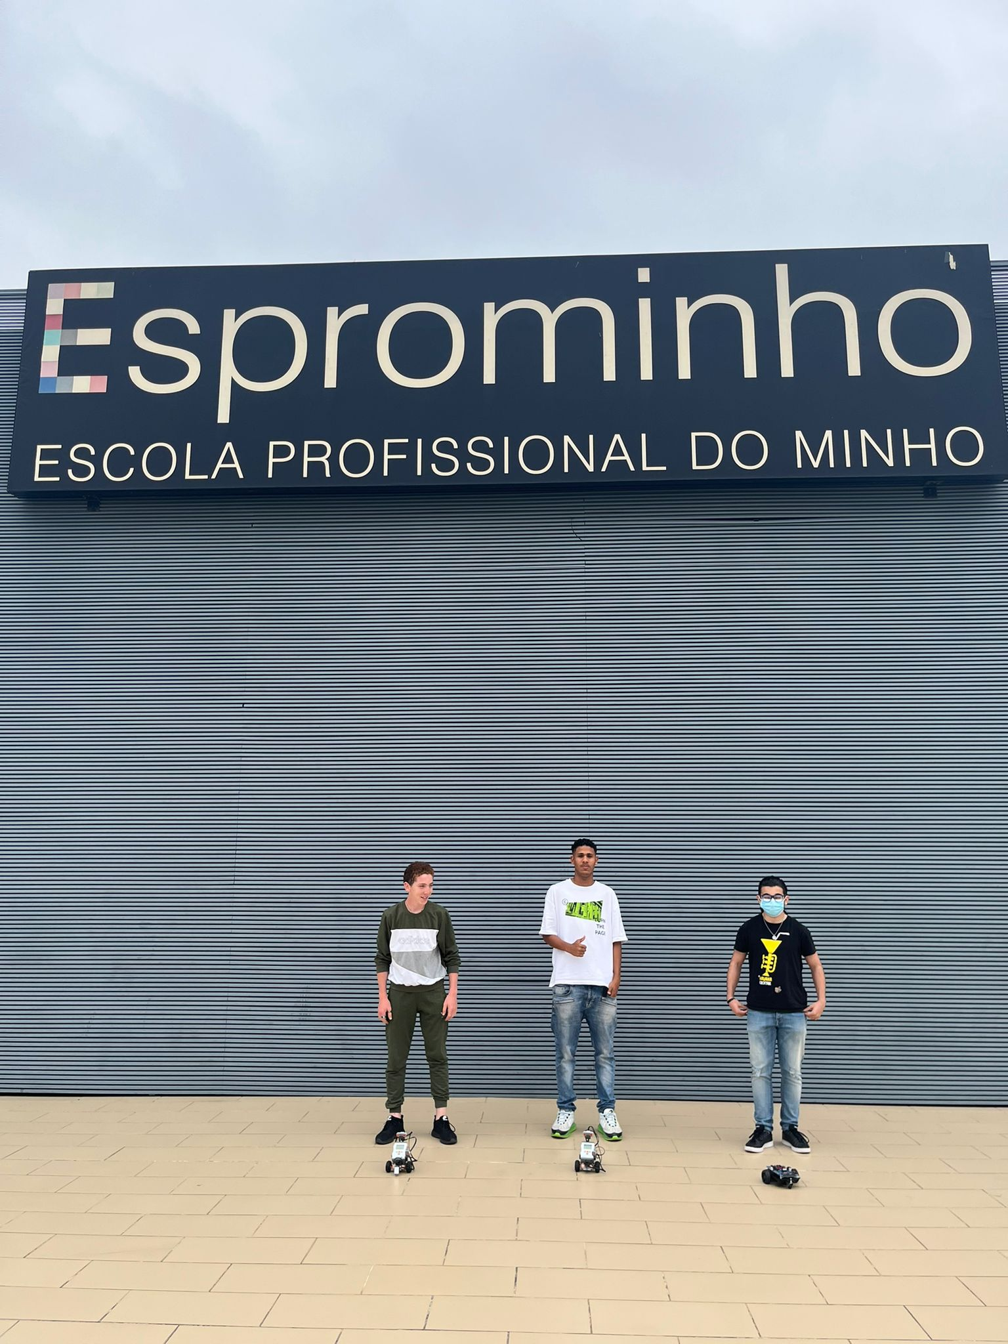
May 22

Slide 10
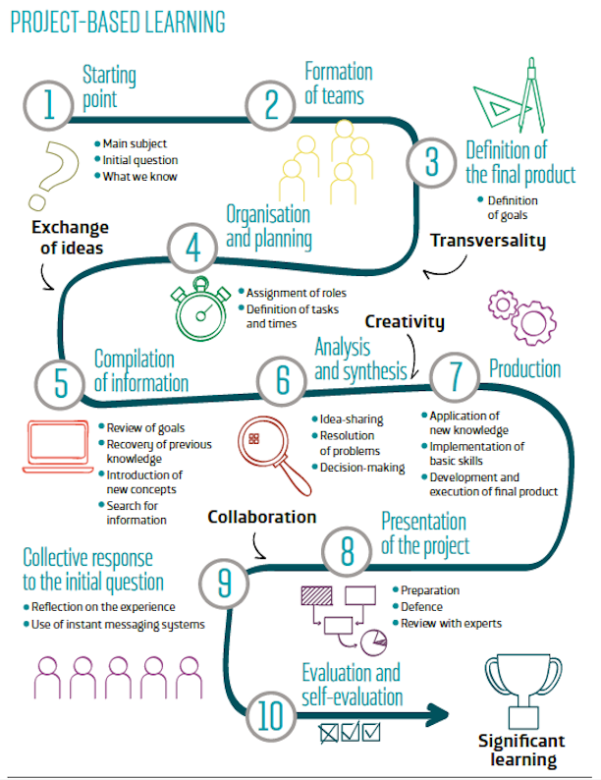
May 22
We are using the PBL – Methodology with our kids

Slide 11
May 22 – In terms of Emotions
• Allowing for an informal environment when working with robots: the informal learning space at the school was more home-like environment, allowing for a more relaxed and non-monitored space.
• Supporting motivation and self-expression: we worked with teachers that can support personalized learning, for example, with tailored learning activities, or by allowing more freedom to learners in selecting their topics of investigation. Students can also develop their personal learning portfolios ( is something that they will do).
• Using personal learning devices: personal learning devices, like netbooks and tablets, gave us access to online resources and virtual learning environments both at home and at school.
• Adopting ways to recognize informal learning: learning diaries and portfolios can be used to keep track of informal learning.
• Flipped classroom: students they were invite to engage in well-structured independent learning at home, allowing the teacher to devote the time in the classroom to project work and collaboration.
• Learning through play: providing educational games for pupils to use during breaks and
after school.

Slide 12
May 22 – In terms of Emotions
• Peer-to-peer collaboration: learning to communicate and work with others is probably one of the most valuable skills a student can learn.
• Teamwork for better inclusion: working in groups can teach students to take into account differences between learners (e.g. gifted – less gifted).
• Learning by playing: playing is common to all students. Robots and simulations were used to introduce more engaging learning.
• Collaborating online: the exchange can be extended to after-school tasks with the aid of an online learning environment and supervised use of social networks.
• Letting ideas fly: brainstorming is a great group activity, allowing pupils to exercise their natural creativity and imagination.

Slide 13
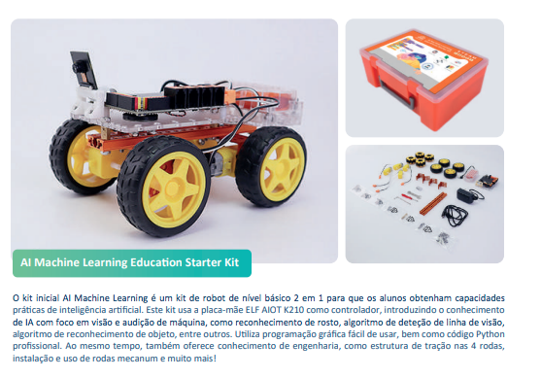
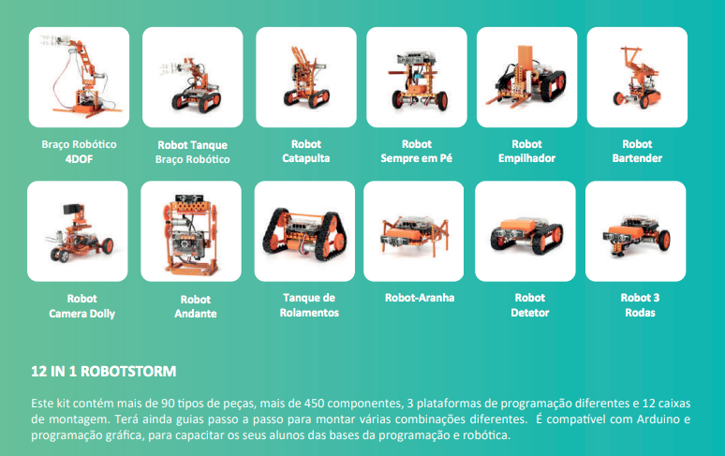
June 22 – Last Period
• We will try to work with STEAM and AI Machine – Weebot – 12 in 1 - ROBOTSTORM

Slide 14
June 22 – Last Period –
Apps for Good 2023
https://cdi.org.pt/en/apps-for-good/

