Slide 1
Maximizing your potential
“Emotions and Robotics: A Study Across Different Cultures, Educational Systems and Populations”
2020-1-TR01-KA201-094326
Deventer, 23rd to 27th of May 2022

Slide 2
Welcome to the Netherlands
DATE | TIME | PROGRAM
MONDAY 23rd May 2022 | 09:00 – 10:30 10:30 – 10:45 10:45 – 12:30 12:30 – 13:30 13:30 – 15:00 15:00 – 15:15 15:15 – 16:00 16:00 – 17:00 19:00 – 21:00 | Art for soft skills Coffee Break Art for soft skills Lunch Social and Emotional Learning (SEL) Coffee Break Social Skills Analysing with Drawing Assessments Cultural activities Welcome dinner
TUESDAY 24th May 2022 | 09:00 –10:30 10:30 – 10:45 10:45 – 12:30 12:30 – 13:30 13:30 – 15:00 15:00 – 15:15 15:15 – 16:00 16:00 – 17:00 17:00 - 21: 00 | The role of robotics in SEL: sharing experiences Coffee Break The role of robotics in SEL: sharing experiences Lunch Inclusive education and robotics: How can robotics be used for inclusive education / Coffee Break "Emotions and robotics with video analytics" (Assoc. Dr. Gökhan Akçapınar) Social and Emotional Learning (SEL) and robotics Dinner in Deventer
WEDNESDAY 25th May 2022 | 09:00 – 10:30 10:30 – 10:45 10:45 – 12:30 12:30 – 13:30 13:30 – 15:00 15:00 – 15:15 15:15 – 17:00 19:00 – 21:00 | Robots - When the students deal with Robots what are there people emotions Coffee Break Robots - When the students deal with Robots what are there people emotions Lunch Art, Robots and Democracy Coffee Break Project activities and future projections Dinner in Deventer
THURSDAY 26th May 2022 | 09:00 – 10:30 10:30 – 10:45 10:45 – 12.30 12:30 – 13:30 13:30 – 15:00 15:00 – 15:15 15:15 – 17:00 17:00 – 21:00 | Field visit - University of Twente / Travel Coffee break Field visit - University of Twente / WOT Lunch break Visit TETEM in Enschede Coffee break Visit TETEM in Enschede Dinner in Enschede
FRIDAY 27th May 2022 | 09:00 – 19:00 | “Amsterdam City Hall” Cultural Tour
“Emotions and Robotics: A Study Across Different Cultures, Educational Systems and Populations”
2020-1-TR01-KA201-094326
TEACHER TRAINING MEETING AGENDA
Deventer, 23rd to 27th of May 2022

Slide 6
Which theory do we use…
Eeuwige schoonheid, E.H. Gombrich,
Tekeningen, Gregg Furth
Kindertekeningen, S. Meykens & G. Cluckers
Kinderen geven tekens, Theresa Foks-Appelman

Slide 7
Drawings have common ground within psychology (child psychology)
Psychology of perception
Influence of neurological maturation on visuomotor coordination (age stages)
The integration of perception and pictorial design
The evolution of mental images and representations
The translation of mental images (with both cognitive and emotional dimensions) into graphical schemes
Symbol formation in general
The development of creativity and the place and importance of fantasy, expressivity and differentiation of symbols in drawings
The place of visual images of visual images and graphics in the development of the capacity for verbal and more abstract communication

Slide 8
Influence of neurological maturation on visuomotor coordination (age stages)
Drawing phases
1st Phase:
around 0-3, the “energetic phase”
2nd Phase:
Around 3-5, the “dwarrel (dutch) phase”
Sandwichphase:
The subject establishes their own reality between heaven and earth.

Slide 9
Let's take a closer look at the studies!

Slide 10
Drawings can, after all, provide access to multiple layers of personality development (Meykens & Cluckers, 2000)

Slide 11
Goodenough (1926), attempted to determine intelligence - or developmental coefficient - from finished drawings. *This study was not reliable.

Slide 12
Koppitz (1968, 1984), went on to research and found that there was a rough estimate of intelligence.

Slide 13
Machover (1949), conducted research into emotional and psychoanalytic principles in children's drawings.

Slide 14
For a diagnostic approach to the child's experience of the world, we mainly want to use a hermeneutical method. Findings and insights from different angles form the basis for the perceptions and the living environment of the child.

Slide 15
Warm-up Energetic drawing
Task 1.
Learning goals: -The team members can make a drawing by feeling. -The team members can link a feeling to motor actions without judgement. -You are able to associate image

Slide 16
Explanation Task 1.
Take a wax cubes. We are going to start drawing calm smooth lines on paper. You are dancing across the sheet of paper, as it were. And move with your body. This may feel uncomfortable at first. Try not to judge. After all, it's about the experience.
Material: paper and wax cubes.

Slide 17
Next task 1A: Take a complementary color. Make sure you can get the fish out with a different color. So that you accentuate the fish.

Slide 18
Task 2. "A TREE OF A GUY"
Just like people, there are tree species that open outwards (being extroverted). Other people wait quietly (are introverted). The latter invite you to think, to sort things out or to relax.
Extroverted trees have the strongest appearance during the day. Introverted trees are more energetic at night, especially during a full moon. Different tree species react most strongly to the sun or the moon.
Draw a tree in an environment that feels right to you.
Learning goals
The team members can draw and color a tree. The team members can display a tree by looking closely at the whole, the parts and proportions.
- Team members can use the whole sheet of paper and depict the tree in it well. Is the composition balanced?
- Team members can display their own tree by color and pay attention to the shape and environment of the tree.
- The team members can deal with feedback and are able to reflect on their own and each other's visual works. Is that visible?
- The team members can use the entire sheet of paper and depict the tree well in it. Is the composition balanced?
- The team members can represent their own tree by means of color and pay attention to the shape and environment of the tree. - The team members can deal with feedback and are able to reflect on their own and each other's visual work.

Slide 19
Task We will first look at a number of images of trees. Also look at the shapes and colors. Are you going to color your tree in a daytime or nighttime environment? You make a drawing of a tree and color an environment. Pay close attention to the shape of the branches. We are going to analyze the drawings. What stands out in your drawing? Then, if there is enough time, we will combine your drawing with the drawings of the other people in your group in a joint assignment. So you are going to put drawings together by means of technique. This creates a 'forest' on paper. Final Task: Create a group collage To conclude, we will review the entire project. We use an analysis form for this. What has it brought us? What insights and how does this feel for you? Would you like to know more about yourself and in combination with your drawing?

Slide 20
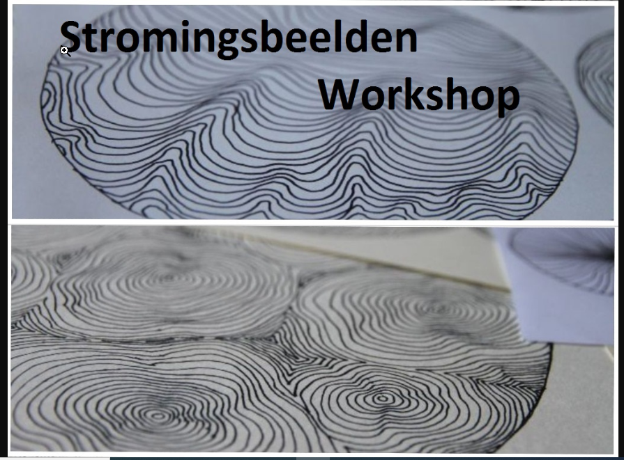
Flow images
Flow images are flowing line drawings on paper.
They are mainly organic and can take all kinds of shapes. It is the intention that one fluently connects to the inventive line drawing of another.
They take turns looking for connections. The color is initially black for the lines.
These are made with a waterproof marker. Then we could choose to color this, with text markers.

Slide 21
Making flow images is very accessible, everyone can do it!
You use a fineliner, markers and paper.
Making these lines has many advantages:
liberating
Move energy.
soothing.
It's like meditating, your head becomes empty and time seems to no longer exist.
Connection with yourself. By being so calm with making lines, space is created to experience a deeper contact with yourself.
Increase self confidence.
Insight.
The drawing exercise mirrors how you flow in life. It is always nice to recognize how you stand in life, this insight can also help you if you want to do things differently in your life. Then you are busy communicating with yourself, making the invisible visible.
Pattern Breaking
Creativity and imagination are stimulated. You don't need anything for these exercises, the process goes by itself by following what is already there. And by 'doing nothing' it becomes much easier to shape new ideas, your judgments are more or less switched off. The more you experience that nothing is expected, the easier you will feel the freedom to experiment. Making current images is also very stimulating.
Impulse for artistry. At some point you can go one step further and start thinking bigger, outside the lines and boxes. What does the interplay of lines evoke in you and what else can you do with it?

Slide 22
In a nutshell
Tree:
Symbolizes the self: How do I see the world? Am I down-to-earth or am I free spirited?
Roots:
Desires and personal background. Do you have strong roots? Are you confident in your opinions? To what extent are you willing to defend your point of view? Do you radiate strength?
Trunk:
Feelings.(If the trunk is colored in in a streamlined fashion, this indicates a fluent state of mind) Do you have a thick or thin trunk?
Crown:
Thought, fantasy and imagination. It connects heaven and earth, imagination and reality.
House:
Do I feel at home in my body?
Flowers:
Indicate our mental abilities. Evaluate the quality and position of the drawn flower; sideview or frontal view? The flower stands for capabilities to be open to light/harmony, gratefulness, generosity, grace and beauty.

Slide 23
Analysis Flower: How open or closed is the flower that the subject has drawn? This will tell you about the subject’s mental capabilities. Sun: Symbolizes male energy and power. In particular, the energy/power of the father, brother, uncle and/or other male relatives Moon: Symbolizes female energy and power. In particular, mother, sister, aunt and/or other female relatives. Stars: Symbolize wishes Castle: Represents your own body (Like a home) Windows: Represent social contact. Am I open or closed off? Am I approachable and social towards other people? Animals: Represent social and emotional intelligence, instinctive vitality, spontaneous desires and displeasures that you can allow while working with animals. Spider: Represents de boundary between light and dark, dirty and clean.

Slide 24
Water: Symbolizes emotional life Air: Symbolizes our thoughts and rationality Clouds: White clouds represent our dreams and desires The neck: Represents the ability to express, ventilate, inform something on time or process grief. Blood: Symbolizes personal strength Prison: Indicates isolation Stone: Represents the physical aspect of the body Black-and-white drawing: Always stands for exploration and mental activity Ground: The base (on which you can build)

Slide 25
Axis
Social axis:
If the paper is oriented to be wider than it is long
Individual axis:
If the paper is oriented to be longer than it is wide
Motor function
This is connected to subconscious physical and/or mental information

Slide 26
KIEST METHOD
Kleur (Color): Has color been used? In which way? Are they bright or dull?
Interactie (interaction): Composition, interconnections. Is there contact or are there any interactions?
Energie (Energy): How much energy is in the drawing? Is it harsh or soft, filled or empty, curved or straight?
Symboliek (Symbolism): Flowers, looking for symbols?
Tijd(Time) en Ruimte(Space): ***The left part of the drawing looking from top to bottom can be read as follows: recently
past history
***The middle part of the drawing looking from top to bottom can be read as: Help/Consciousness The here and now Subconscious
***The right part of the drawing looking from top to bottom can be read as follows: Immediate future Future Far future

Slide 27
Additional tips for reading a drawing How can I get SOMETHING from unconscious to conscious? What has been drawn? 1st impression - ask what it was like doing it? What stands out? What is there too much of? What is there not enough of? Strength - weakness analysis, naming qualities What is missing, where is the problem and what did not work out well? Do you want to add or change something? Every aspect of your drawing is also an aspect of you. When you make a drawing, it is a reflection of yourself.

Slide 28
Contact and contract
In contact and contract, the pedagogical qualities of didactic coaching are examined. Qualities that are necessary to have an open (Socratic) conversation with the pupil, in which the pupil dares to be himself and dare to be vulnerable. This requires clear exemplary behavior from the coach by making good contact with the youngster and giving the youngster a sense of self-worth. finally, the coach also makes himself vulnerable by asking the youngster for feedback.
Indicators | Expert | Standard | Developmental
Learning environment Safe, clear and open | the coach allows the youngster to play a clear-cut role in a safe learning climate | the coach provides a learning environment in which the youngster dares to be vulnerable | the coach makes agreements with the youngster about the learning environment
Attention | the coach remains authentic and focuses on conscious attention | the coach empathizes with the youngster and checks this with them | the coach pays conscious attention to the youngster by watching and listening carefully
Equal |  | the coach respects the autonomy of the youngster
Personal qualities |  | the coach leaves room for specific personal qualities of the youngster
Feedback |  | the coach gives the youngster the space to give feedback to the coach

Slide 29
