Slide 1
BETTER UNDERSTANDING HIGH SCHOOL STUDENTS
By Tuna Mert İyiarı

Slide 2
About the Study
In order to share with you what happened on the part of high school students in this project on technology, robotics, emotion and education, I interviewed 12 of my friends on specific questions.
In this presentation, I share the process of these interviews with you.

Slide 3
The answers to the following questions were sought.
How and for what purpose do you use technology? What are you up to?
Which technology (applications/tools (Web, mobile app, social media, etc.)) do you use the most? Why?
Which technology (applications/which devices) do you use most about your lessons? Why?
How do you feel when using technology (mobile phone, youtube…)? What emotions are you experiencing?
How would you feel if you don't have/can't use technology?
What comes to mind when you think of robot / robotics / robotic coding / programming? What do you know about it? Have you received any training on these topics?
What emotions do you experience while working with robotics?

Slide 4
The answers to the following questions were sought.
8. Regarding the lessons:
What is your favorite lesson/s? Why?
What is your least favorite lesson/s? Why?
What do you think plays a role in experiencing these emotions?
Are you satisfied with the content of the lessons, the method of teaching, and the teachers? How would you like it? Why?
9. How would you describe yourself in general? How do you feel in your daily life? How's the temperament?
10.. What kind of life do you think awaits you? What plays a role in making you feel this way?
11. Does the education you receive now meet your expectations for the future? What kind of education would you like?
12. What would you like to do about being useful to society? How can you benefit from technology in this regard? Do you have any suggestions?

Slide 5
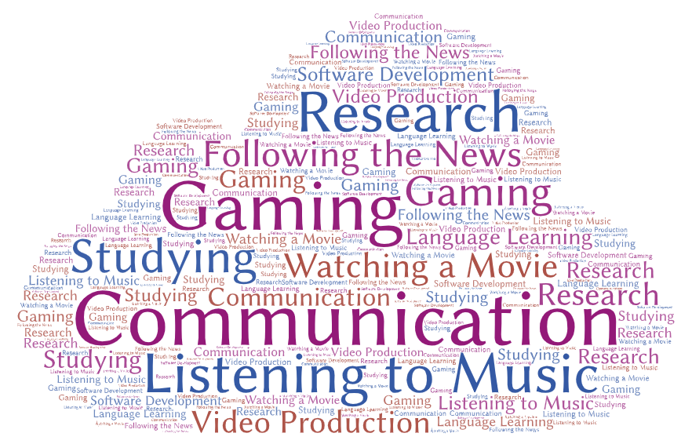
Purpose of the Usage of Technology
There are many reasons to use technology. These reasons differ from person to person. Some examples are:
Entertainment
Research
Hobbies(Gaming…)
Communication
…..

Slide 6
“I use technology to follow the news and keep in touch with my friends and family.”
“I use technology to watch stuff and research.”

Slide 7
Most Popular Apps
YouTube stands out as the most popular app among high schoolers.

Slide 8
Most Popular Apps For Studying
YouTube stands out as the most popular app once again.
“I use desmos for my maths course.”
“I mostly use YouTube to study and review what I’ve learnt in my classes.”

Slide 9
Emotional Outcomes of Using Technology Regularly
Although some feel moody, exhausted, or just bored, most students feel happy and relieved whenever they use their favorite apps and devices.
“Most of the time I feel happy. I have fun on social media. Though sometimes I feel bad for spending so much time on my phone.”
“I get very tired when I look at my phone for a long time.”

Slide 10
What Would Students Feel and Do Without Technology
The majority of students expressed their concerns and disapproval about a life without technology. Almost every student agreed that they would feel confused, sad, or even depressed.
“Without technology, my life would be significantly harder.”
“I would feel incomplete without my phone.”
“Have you ever went back to 16th century? I haven’t and wouldn’t want to…”

Slide 11
How Familiar are High School Students
with Robotics and Software Development?
Most students are not familiar with robotics and software development.
Students that are familiar with these subjects are mostly self taught.
“I know the C# coding language. I am self-taught.”

Slide 12
Which lessons

Slide 13
Most - Least Favorite Lessons
Most students expressed their love for mathematics. A significant amount of students’ favorite classes are science oriented classes.
“I love math. Especially geometry.”
“Math because I am good at calculating things.”
Physics appears to be the most commonly disliked lesson.

Slide 14
Students on Why They Dislike Certain Classes
Although every student’s explanation for their feelings was unique and different, some answers had similarities. One similarity was they disliked memorizing.
“I don’t like memorizing because I’m bad at it.”
“Instead of memorizing, I prefer understanding the reason behind things and concepts.
Another similarity was their relationships with their teachers.
“My previous teachers caused me to lose interest on some subjects.”

Slide 15
Students’ Opinions on Teachers and Instructional Methods
Most students like and appreciate their teachers. Some students have various criticisms about their teaching methods.
“I believe my teachers are doing the best they can. However I sometimes feel like they overexplain stuff.” “I like the way my teachers teach. I wish they taught us in a more practical way though.”

Slide 16
Students’ Opinions on Contents of Curriculum
Some students believe that the curriculum is too extensive and detailed while others think it’s satisfactory.
Some students suggest reducing the contents of the curriculum in order to make school less overwhelming.
“Some lessons are too detailed for a high school lecture. Reducing unnecessary details could be a good idea.”
“I don’t have any issues with the current curriculum. It is perfectly fine.”

Slide 17
How High Schoolers Describe Themselves
Most students think positively about themselves. Common traits are being hardworking, curious, optimistic and introverted.
“I am very curious and energetic.”
“I am a well-meaner. I am not very sociable but I am surrounded by the few I love the most. I am a merry, joyful person.”

Slide 18
Students on Their Future Lives
Most students have an optimistic outlook on their future lives. Similarly, most students plan on striving for their goals. Some, however, expressed their anxiety over not precisely knowing what the future will be like.
“I don’t know what may happen in the future but plan on working hard. I don’t want to have any regrets when I grow up.”

Slide 19
Students on Their Expectations from Education
Minority is satisfied with the education they are receiving, majority states that their expectations are not met. The majority thinks that they are not being prepared properly for the future.
“I don’t think that I am being prepared for the future.”

Slide 20
In Conclusion
In the end I realized that although people’s thoughts may have similarities, everyone’s emotions are unique. Everyone has slight differences in their opinions.

Slide 21
Thank you

